Slide 1
NATIONAL ENVIRO ENGINEERING
PRESENTS
MODULAR RAIN WATER HARVESTING SYSTEM
Notes:
This template can be used as a starter file to give updates for project milestones.
Sections
Right-click on a slide to add sections. Sections can help to organize your slides or facilitate collaboration between multiple authors.
Notes
Use the Notes section for delivery notes or to provide additional details for the audience. View these notes in Presentation View during your presentation.
Keep in mind the font size (important for accessibility, visibility, videotaping, and online production)
Coordinated colors
Pay particular attention to the graphs, charts, and text boxes.
Consider that attendees will print in black and white or grayscale. Run a test print to make sure your colors work when printed in pure black and white and grayscale.
Graphics, tables, and graphs
Keep it simple: If possible, use consistent, non-distracting styles and colors.
Label all graphs and tables.

Slide 2
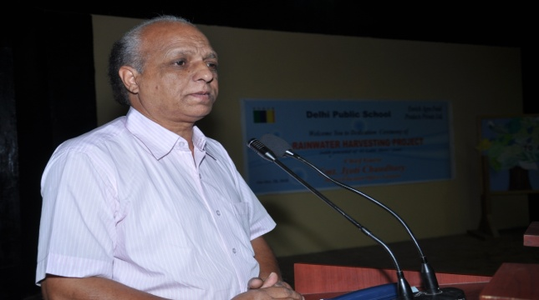
ABOUT PROPRIETOR OF NEE
          Mr. R. C Sharma , A Scientist of International Cadre. Attended Training programmes in the field of Hydrology and Hydrometerology,rain water harvesting ,at
          NOOA,USA, & SMHI Sweden
          Served Central Ground water Board , MOWR , GOI for about 35 years
          With vast experience in hydrology , Hydro-meteorology, Hydro-geology and Rain water harvesting.
          Conducted various Training and Awareness program for all stake holders on water Conservation harvesting for Ground water Recharge & Augumentation.
          Piezometer is one of the leading product Launched by National Enviro engineering
          Now working as consultant of water resource management in Pan India
          Sole proprietor “National Enviro Engineering “.A leading Company in the field of Water Resources Management
          Association with Leading NGOs, WAPCOS etc.

Slide 3
STRESS ON GROUND WATER
(Possible Solutions)
Shifting of ground water pumpage from the center of the cities to flood plain areas having proven capabilities of sustaining high yielding tube wells wherever possible,
Recycling and reuse of water,
Dual water supply systems for drinking and other domestic uses,
Roof Top Rainwater Harvesting and
Regulatory measures through proper pricing and metering of water supplied.
Artificial recharge to Ground Water
“Any procedure, which introduces water in a pervious stratum”.
Notes:
This template can be used as a starter file to give updates for project milestones.
Sections
Right-click on a slide to add sections. Sections can help to organize your slides or facilitate collaboration between multiple authors.
Notes
Use the Notes section for delivery notes or to provide additional details for the audience. View these notes in Presentation View during your presentation.
Keep in mind the font size (important for accessibility, visibility, videotaping, and online production)
Coordinated colors
Pay particular attention to the graphs, charts, and text boxes.
Consider that attendees will print in black and white or grayscale. Run a test print to make sure your colors work when printed in pure black and white and grayscale.
Graphics, tables, and graphs
Keep it simple: If possible, use consistent, non-distracting styles and colors.
Label all graphs and tables.

Slide 4
ADVANTAGES OF ARTIFICIAL RECHARGE
Subsurface storage space is available free of cost .
Evaporation losses are negligible .
Quality improvement by infiltration through the permeable media .
Biological purity is very high .
It has no adverse social impacts such as displacement of population, loss of scarce agricultural land etc .
It is environment friendly, controls soil erosion and flood and provides sufficient soil moisture even during summer months .
It provides a natural distribution system between recharge and discharge points .
Results in energy saving due to reduction in suction and delivery head as a result of rise in water levels
Notes:
This template can be used as a starter file to give updates for project milestones.
Sections
Right-click on a slide to add sections. Sections can help to organize your slides or facilitate collaboration between multiple authors.
Notes
Use the Notes section for delivery notes or to provide additional details for the audience. View these notes in Presentation View during your presentation.
Keep in mind the font size (important for accessibility, visibility, videotaping, and online production)
Coordinated colors
Pay particular attention to the graphs, charts, and text boxes.
Consider that attendees will print in black and white or grayscale. Run a test print to make sure your colors work when printed in pure black and white and grayscale.
Graphics, tables, and graphs
Keep it simple: If possible, use consistent, non-distracting styles and colors.
Label all graphs and tables.

Slide 5
IMPLEMENTATION OF ARTIFICIAL RECHARGE SCHEMES
Successful implementation of artificial recharge schemes will essentially involve the following major components .
Assessment of source water .
Planning of recharge structures .
Finalisation of specific techniques and designs .
Monitoring and impact assessment .
Financial and economic evaluation .
Operation and maintenance.
Notes:
This template can be used as a starter file to give updates for project milestones.
Sections
Right-click on a slide to add sections. Sections can help to organize your slides or facilitate collaboration between multiple authors.
Notes
Use the Notes section for delivery notes or to provide additional details for the audience. View these notes in Presentation View during your presentation.
Keep in mind the font size (important for accessibility, visibility, videotaping, and online production)
Coordinated colors
Pay particular attention to the graphs, charts, and text boxes.
Consider that attendees will print in black and white or grayscale. Run a test print to make sure your colors work when printed in pure black and white and grayscale.
Graphics, tables, and graphs
Keep it simple: If possible, use consistent, non-distracting styles and colors.
Label all graphs and tables.

Slide 6
CO-EFFICIENT OF RUNOFF
(For comptation of rainfall-runoff availability)
Urban Residential : 0.3 - 0.5
Forests : 0.05 - 0.2
Commercial & Industrial : 0.9
Parks, farms, Pastures : 0.05 - 0.3
Asphalt or concrete pavement : 0.85
GI Sheet :0.9
Asbestos :0.8
Tiled :0.75
Concrete :0.7
Notes:
This template can be used as a starter file to give updates for project milestones.
Sections
Right-click on a slide to add sections. Sections can help to organize your slides or facilitate collaboration between multiple authors.
Notes
Use the Notes section for delivery notes or to provide additional details for the audience. View these notes in Presentation View during your presentation.
Keep in mind the font size (important for accessibility, visibility, videotaping, and online production)
Coordinated colors
Pay particular attention to the graphs, charts, and text boxes.
Consider that attendees will print in black and white or grayscale. Run a test print to make sure your colors work when printed in pure black and white and grayscale.
Graphics, tables, and graphs
Keep it simple: If possible, use consistent, non-distracting styles and colors.
Label all graphs and tables.

Slide 7
ARTIFICIAL RECHARGE TECHNIQUES - used for artificial recharge to ground water broadly fall under the following categories
A.Direct Methods
Surface Spreading Techniques a) Flooding b) Ditch and Furrows c) Recharge Basins d) Runoff Conservation Structures i) Bench Terracing ii) Contour Bunds and Contour Trenches iii) Gully Plugs, Nalah Bunds, Check Dams iv) Percolation Ponds e) Stream Modification
Indirect Methods
A) Induced Recharge from Surface Water Sources; B) Aquifer Modification i) Bore Blasting. ii) Hydro-fracturing.
Notes:
This template can be used as a starter file to give updates for project milestones.
Sections
Right-click on a slide to add sections. Sections can help to organize your slides or facilitate collaboration between multiple authors.
Notes
Use the Notes section for delivery notes or to provide additional details for the audience. View these notes in Presentation View during your presentation.
Keep in mind the font size (important for accessibility, visibility, videotaping, and online production)
Coordinated colors
Pay particular attention to the graphs, charts, and text boxes.
Consider that attendees will print in black and white or grayscale. Run a test print to make sure your colors work when printed in pure black and white and grayscale.
Graphics, tables, and graphs
Keep it simple: If possible, use consistent, non-distracting styles and colors.
Label all graphs and tables.

Slide 8
CHECK WITH WATER AVAILABILITY FROM ROOF TOP WATER AVAILABLE FROM ROOF TOP =
Annual rainfall (in mm) = 1000
X Area of roof (in sq.m)=20
X Coefficient of runoff for the roof =0.75
= 1000 X 20 X 0.75 = 15000 liters
Storm Water Available
Per Storm Rainfall* Area of roof * Coefficient of runoff for the roof
Notes:
This template can be used as a starter file to give updates for project milestones.
Sections
Right-click on a slide to add sections. Sections can help to organize your slides or facilitate collaboration between multiple authors.
Notes
Use the Notes section for delivery notes or to provide additional details for the audience. View these notes in Presentation View during your presentation.
Keep in mind the font size (important for accessibility, visibility, videotaping, and online production)
Coordinated colors
Pay particular attention to the graphs, charts, and text boxes.
Consider that attendees will print in black and white or grayscale. Run a test print to make sure your colors work when printed in pure black and white and grayscale.
Graphics, tables, and graphs
Keep it simple: If possible, use consistent, non-distracting styles and colors.
Label all graphs and tables.

Slide 9
Rainwater Harvesting Potential (Guwahati)
Catchment area – 100 square metres (sq. m)
Average annual rainfall in Guwahati – 1,600 millimetre (mm)
Total water available from rainfall – 136.000 cubic metre (m3) or 1,36,000 litres
Notes:
This template can be used as a starter file to give updates for project milestones.
Sections
Right-click on a slide to add sections. Sections can help to organize your slides or facilitate collaboration between multiple authors.
Notes
Use the Notes section for delivery notes or to provide additional details for the audience. View these notes in Presentation View during your presentation.
Keep in mind the font size (important for accessibility, visibility, videotaping, and online production)
Coordinated colors
Pay particular attention to the graphs, charts, and text boxes.
Consider that attendees will print in black and white or grayscale. Run a test print to make sure your colors work when printed in pure black and white and grayscale.
Graphics, tables, and graphs
Keep it simple: If possible, use consistent, non-distracting styles and colors.
Label all graphs and tables.

Slide 10
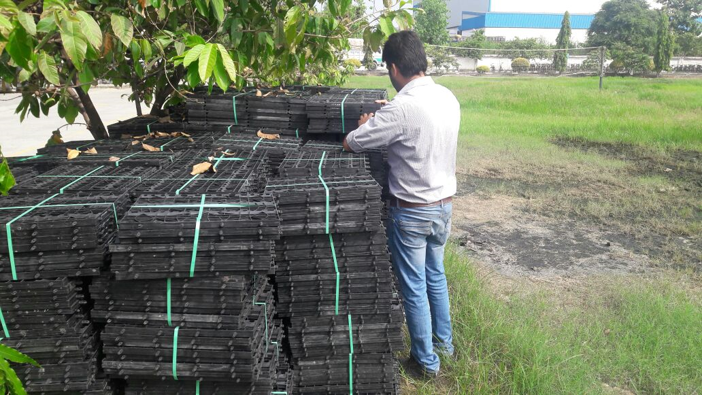

Slide 11
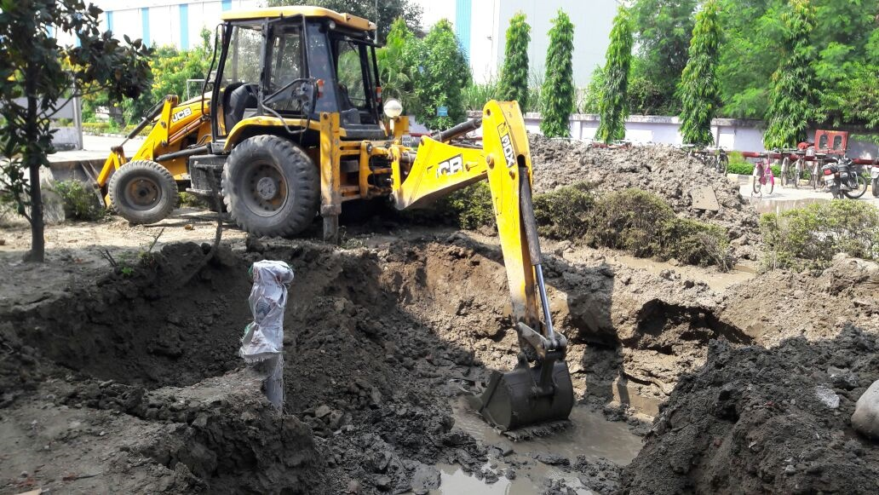

Slide 12
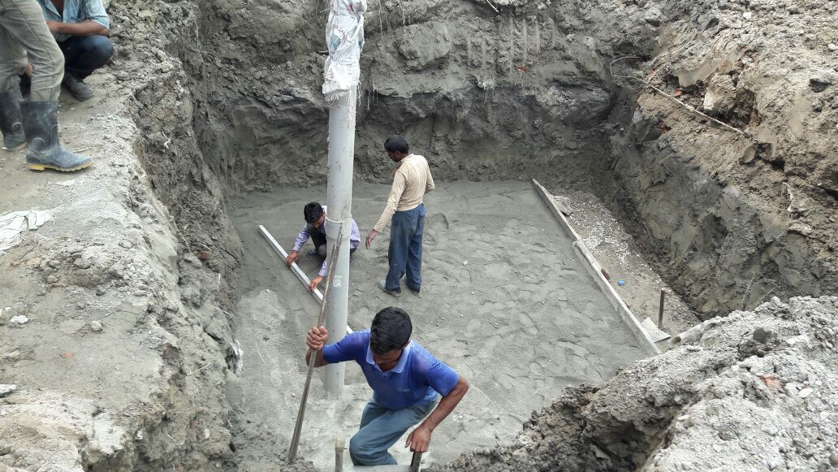

Slide 13
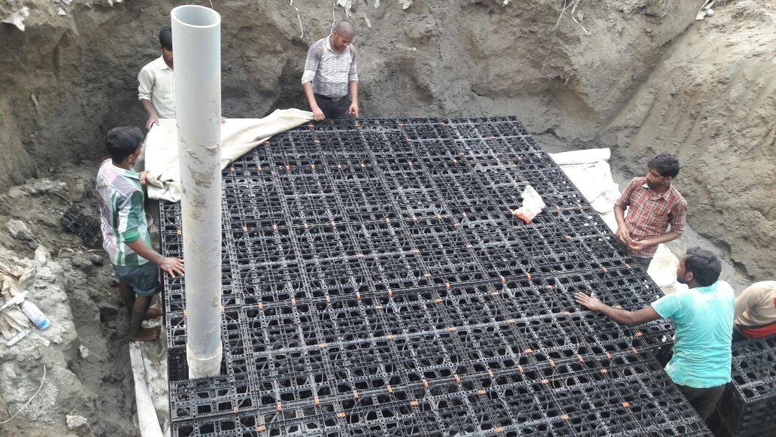

Slide 14
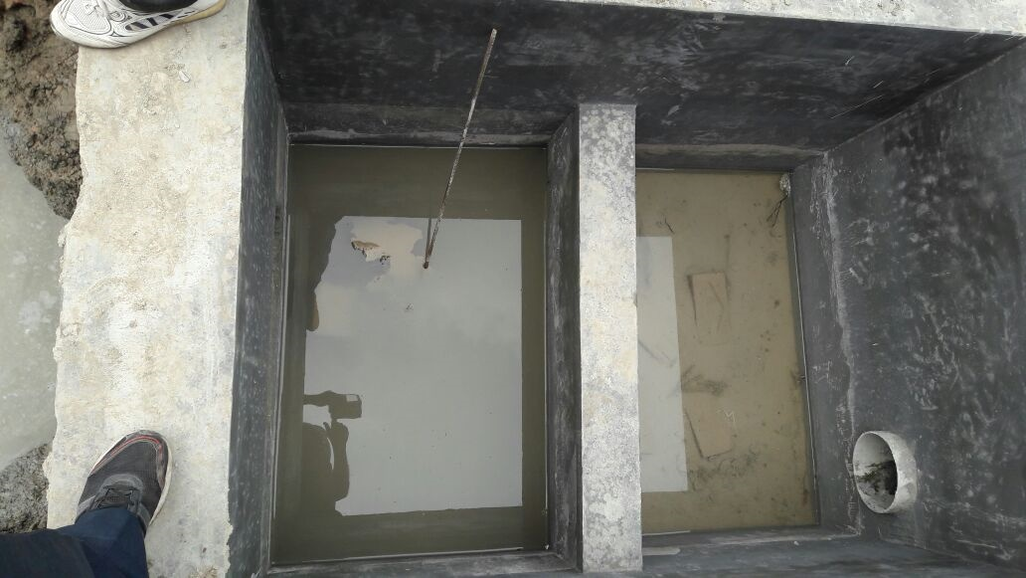

Slide 15
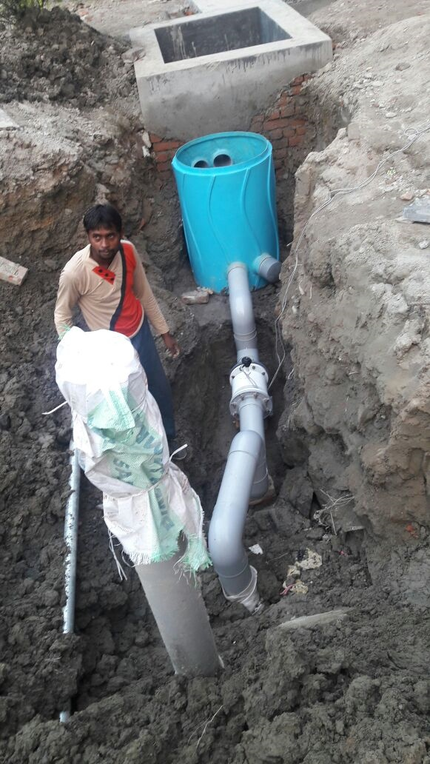
Heavy Duty RWH Filter
INR 30000/-

Slide 16
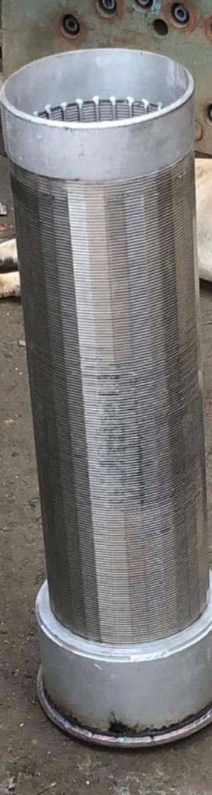
S S Filter
For RWH
Of different Sizes
50 cm/100cm
COST INR 20000/-
Notes:
This template can be used as a starter file to give updates for project milestones.
Sections
Right-click on a slide to add sections. Sections can help to organize your slides or facilitate collaboration between multiple authors.
Notes
Use the Notes section for delivery notes or to provide additional details for the audience. View these notes in Presentation View during your presentation.
Keep in mind the font size (important for accessibility, visibility, videotaping, and online production)
Coordinated colors
Pay particular attention to the graphs, charts, and text boxes.
Consider that attendees will print in black and white or grayscale. Run a test print to make sure your colors work when printed in pure black and white and grayscale.
Graphics, tables, and graphs
Keep it simple: If possible, use consistent, non-distracting styles and colors.
Label all graphs and tables.

Slide 17
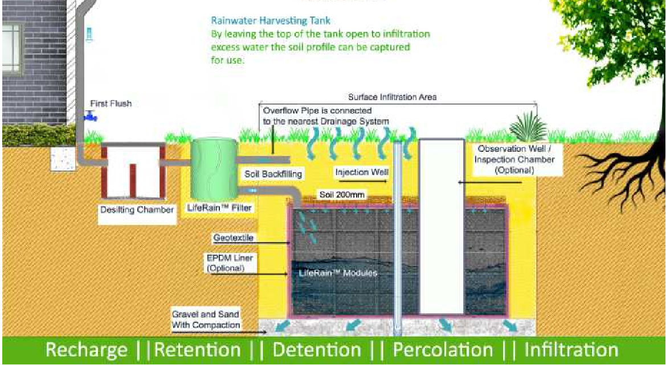
MODULAR RAINWATER HARVESTING SYSTEM
IT IS SAFE, EASY TO MAKE AND EASY TO MAINTAIN
Notes:
* If any of these issues caused a schedule delay or need to be discussed further, include details in next slide.

Slide 18
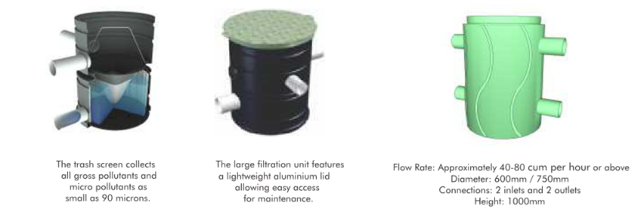
DUAL STEP PREFILTRATION

Slide 19
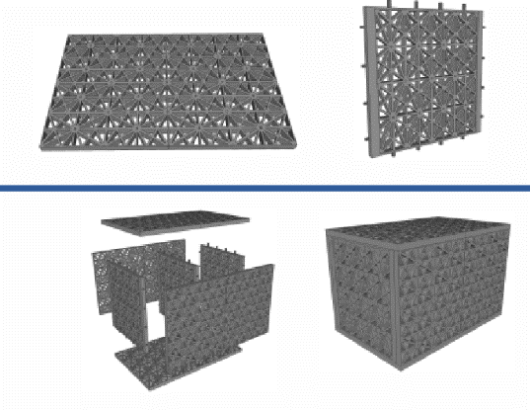
Modular Plates
VOID RATIO: 96.5%
Traffic Bearing Capacity: 40 tons per sqm.
Material used is recycled polypropylene.

Slide 20
Modular System advantage
Polymer as strong as metal.
Eco friendly, qualifies for getting carbon credits.
Can be used for any type of landscaping.
Low maintenance cost.
Time saving in installation.
Easy to expand and relocate according to new site plans.
Long life of 100+ years.
Clog free, safe and highly load bearing.
Strong structural design.
Provides an ecologically sustainable storm water system.
Reduces polluted stormwater runoff.
Accident free, qualifies for LEED/Green Ratings.

Slide 22
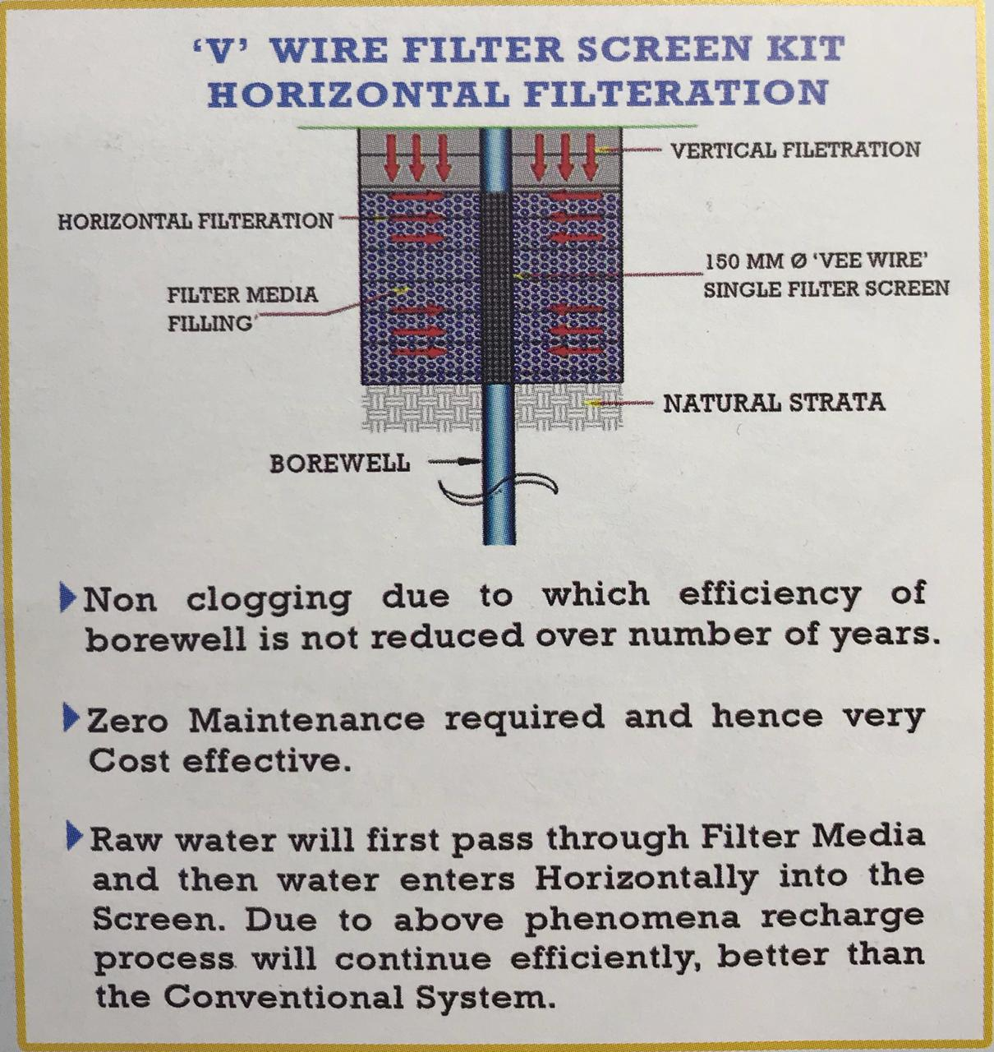

Slide 23
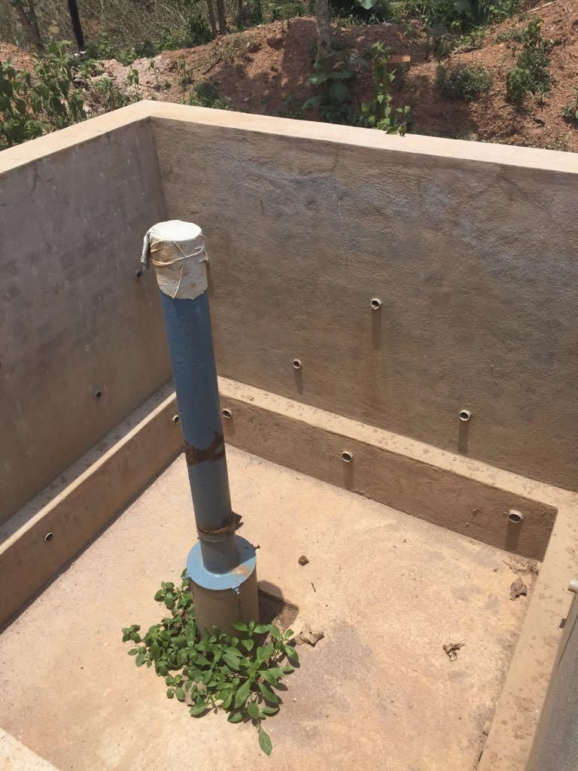

Slide 24
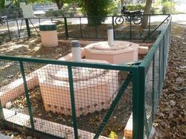
Furaat System ☹Primary & Secondary for Surface Water Pre-Cast Cpncrete RWH System

Slide 25
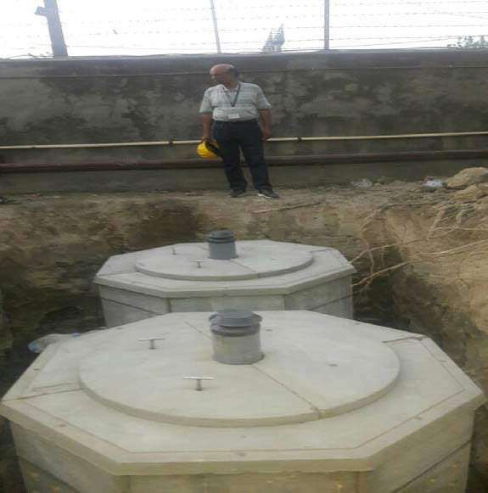
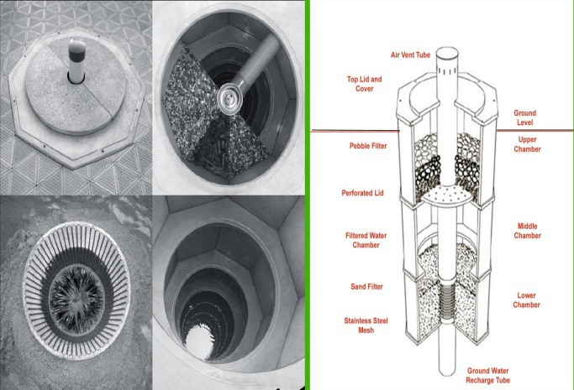
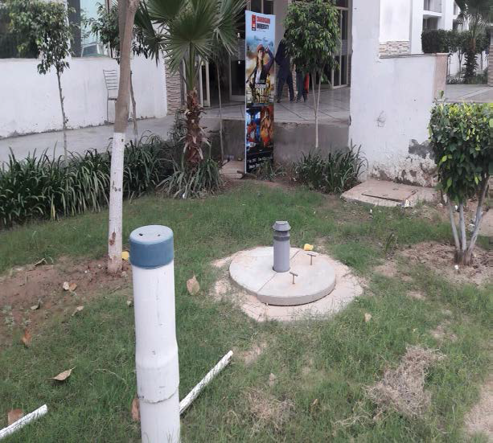
Furaat SystemInstallaed at Chandigarh University

Slide 26
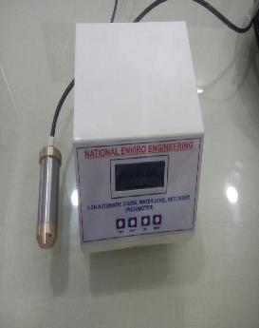
WATER LEVEL SOUNDER/ELECTROMEGNETIC WATER FLOW METER/PIEZOMETER

Slide 27
KEY CLIENTS
Installation Of Piezometer
Modern Eco. Township (Reliance): Jhahjjar
Ultrrech Cement Ltd ,Jhajjar ,Panipat
Dabur India Pvt. Ltd –Rajasthan
Walmart-Raipur & Bhopal
Thaper University –Pb
Knitpro-UP
Molson Coors-Pb
Krish Group-Haryana
Eco-Paryavarn-Mohalli (Pb)
Sonhira SsahakariSakharKLtd.-Kolhapur (Mah)
Eco-tech –Guwahatti(Assam)
Chandigarh University-Kharar,Pb
Goodluck India Pvt. Lt.-UP
Oeroi Hotel –Agra(UP)
Regency Hotel-(UP)
S S Bevarages-Haryana
Unitd Breweries-Patna
Sahu Sk-Kagal(Maharashtra)
Shree Chattarpati SSSK-Kagal(Mah.)
Cheema Boilers Ltd-Kharar (Pb)
GSK –Patiala (Pb)
PZ.Endurance Tec.Ruderpur
PZ.Advik Tech Ruderpur
PZ.MMT Ruderpur
PZ.Aggarwal gas Ruderpur
Sunphatma Sikkim/Guwahati
Others
RWH Through Polymer Technology
Ebro India Pvt. Ltd.-Haryana
Hero Motocorp-UP
Endurance Tech-UK
Eicher Polaris –Kukas,Rajasthan
Chandigarh University-Kharar (Pb)
HIL Ltd-Jaunpur (UP)
Cheema Boilers Ltd-Kharar (Pb)
UAL –Dhinkanal (Odisha)
Tube Product Of India PB

Slide 28
KEY CLIENTS
Installation Of Piezometer
Modern Eco. Township (Reliance): Jhahjjar
Ultrrech Cement Ltd ,Jhajjar ,Panipat
Dabur India Pvt. Ltd –Rajasthan
Walmart-Raipur & Bhopal
Thaper University –Pb
Knitpro-UP
Molson Coors-Pb
Krish Group-Haryana
Eco-Paryavarn-Mohalli (Pb)
Sonhira SsahakariSakharKLtd.-Kolhapur (Mah)
Eco-tech –Guwahatti(Assam)
Chandigarh University-Kharar,Pb
Goodluck India Pvt. Lt.-UP
Oeroi Hotel –Agra(UP)
Regency Hotel-(UP)
S S Bevarages-Haryana
Unitd Breweries-Patna
Sahu Sk-Kagal(Maharashtra)
Shree Chattarpati SSSK-Kagal(Mah.)
Cheema Boilers Ltd-Kharar (Pb)
GSK –Patiala (Pb)
PZ.Endurance Tec.Ruderpur
PZ.Advik Tech Ruderpur
PZ.MMT Ruderpur
PZ.Aggarwal gas Ruderpur
Sunphatma Sikkim/Guwahati
Others
RWH Through Polymer Technology
Ebro India Pvt. Ltd.-Haryana
Hero Motocorp-UP
Endurance Tech-UK
Eicher Polaris –Kukas,Rajasthan
Chandigarh University-Kharar (Pb)
HIL Ltd-Jaunpur (UP)
Cheema Boilers Ltd-Kharar (Pb)
UAL –Dhinkanal (Odisha)
Tube Product Of India PB

